Slide 1
Supporting a better future

Slide 2
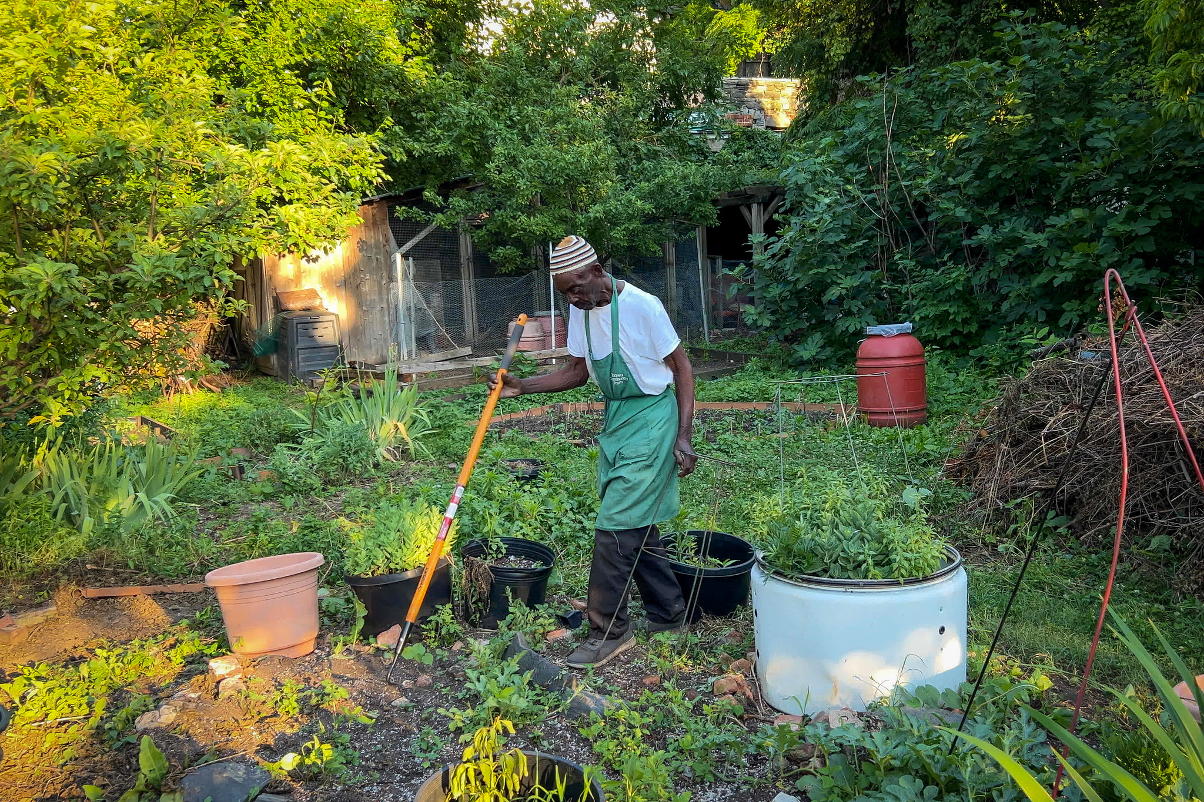
Community Garden in New York
A half-acre park operated as a community garden in the Bronx New York shows us how urban spaces can be adapted.
Location: The Bronx, New York
Photographer: Presten Keres / USDA / FPAC
Notes:
URBAN GARDENING CALIFORNIA
https://climatevisuals.org/groupitem/19/

Slide 3
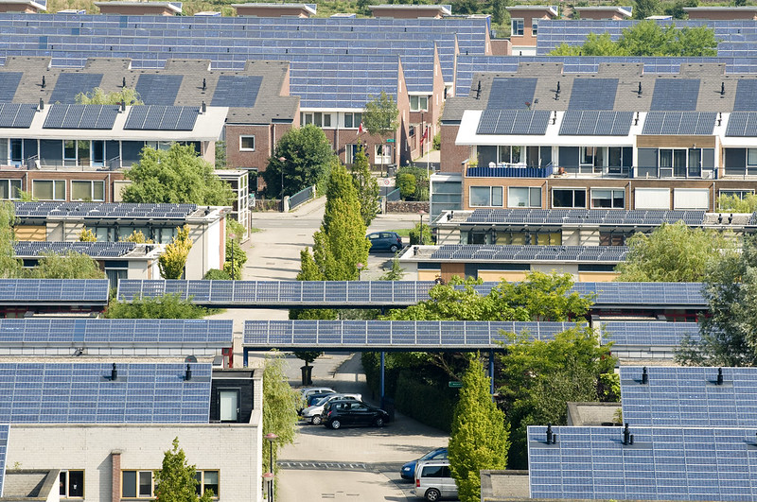
Solar Panels on housing in the Netherlands
Solar panels on the roofs of housing in a neighbourhood in the Netherlands where there are over 12,000m2 of solar panels on 500 homes and other buildings.
Location: Netherlands
Photographer: Eneco Group / Creative Commons
Notes:
SOLAR PANELS ON HOUSING IN THE NETHERLANDS.
https://climatevisuals.org/groupitem/106/

Slide 4
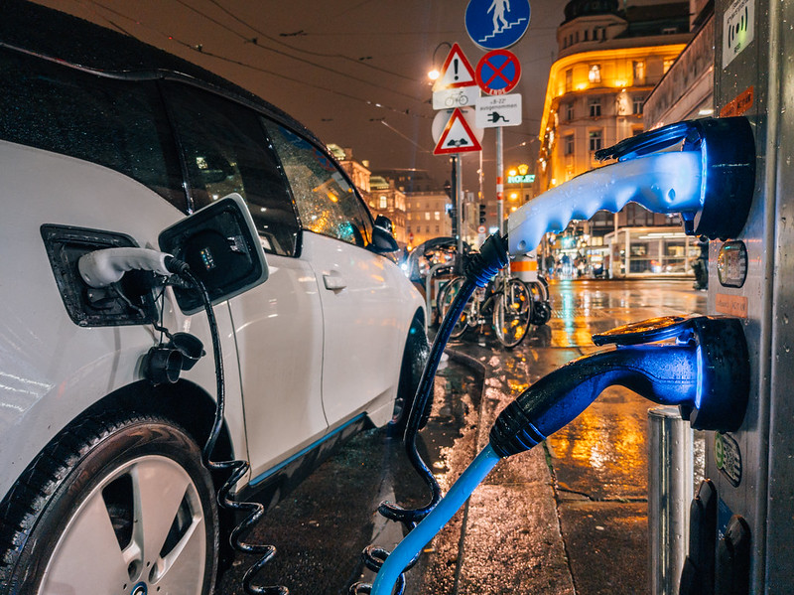
Electric Car Charging
Charging an electric car at night
Location: Germany
Photographer: Eneco Group / Creative Commons
Notes:
ELECTRIC CAR CHARGING
9213
https://climatevisuals.org/groupitem/106/

Slide 5
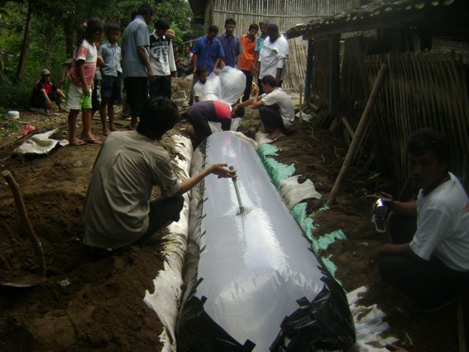
Biogas in Indonesia
An Indonesian community installs a cylindrical plastic biogas reactor in order to turn their organic waste into energy.
Location: Indonesia
Photographer: Perkumpulan Lesman / Creative commons
Notes:
An Indonesian community installs a cylindrical plastic biogas reactor in order to turn their organic waste into energy.Our research found there is a tension between images that are easily understood and those that tell a new story. This unusual image of biogas technology is unlikely to be understood out of context, but the active and dynamic scene depicted shows sustainability 'in action'.
903 BIOGAS IN INDONESIA
Creative Commons, CC BY 2.0Mandatory Credit: Perkumpulan Lesman /Photographer name: Perkumpulan Lesman

Slide 6
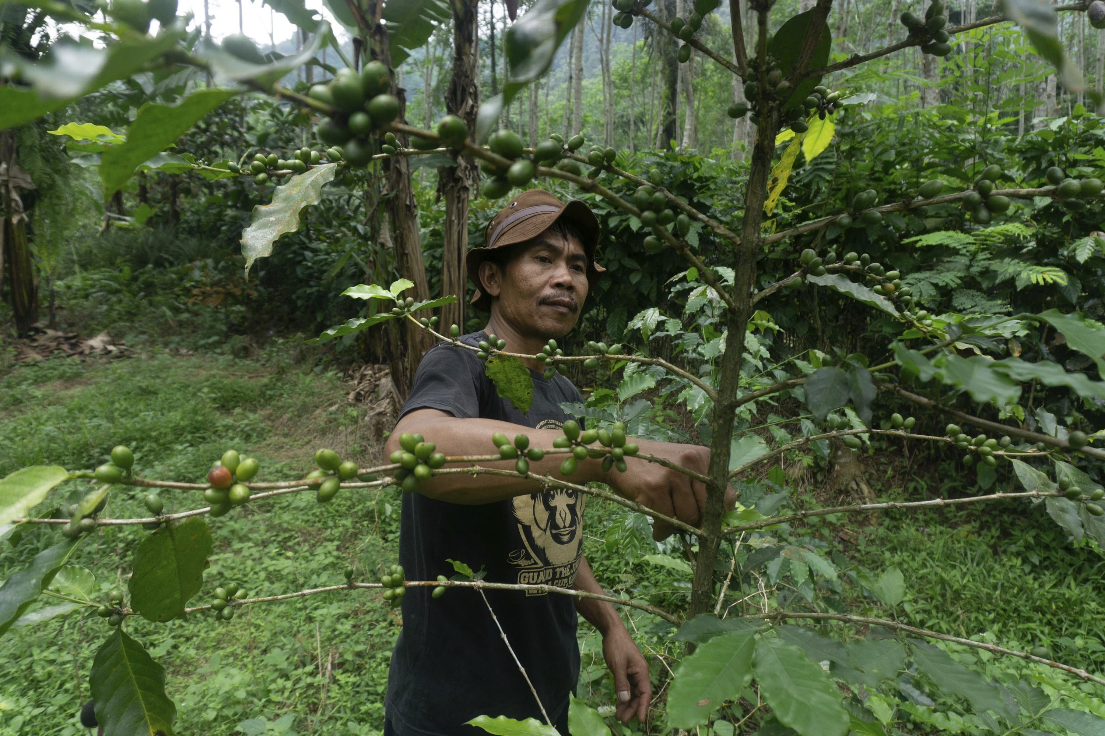
A local forest ranger patrolling the rainforests and wild coffee plantations
Tasuri, former wildlife, and wood hunter taking care of a coffee tree that grows wild in a tropical rainforest, working to keep the forest sustainable and avoid environmental destruction and the adverse effects of climate change.
Location: Central Java, Indonesia
Photographer: Dhana Kencana / Climate Visuals Countdown
Notes:
Tasuri, former wildlife, and wood hunter taking care of a coffee tree that grows wild in a tropical rain forest in Pekalongan, Central Java, Indonesia. He is growing economically independent by developing sustainable and environmentally friendly agricultural business, Owa Coffee products. Owa Coffee is the use of coffee products for the conservation of the Javan Gibbon in the forest which is threatened with extinction and is included in the IUCN red list. Tasuri who lives around the forest has stopped being a hunter and now together with the villagers are rangers to keep the forest sustainable and avoid environmental destruction and the adverse effects of climate change.
City: PekalonganRegion: Central JavaCountry: Indonesia
25/10/2020Agency: Climate Visuals CountdownCreative Commons
Mandatory Credit: Dhana Kencana / Climate Visuals CountdownI am a journalist also photojournalist who has been working in several media in Indonesia for more than 10 years. I am based in Demak, Indonesia. Most of my coverage is issues to environmental, science, social, economic, climate change, wildlife, conservation, and energy.Photographer name: Dhana KencanaPhotographer based in: Indonesia

